Slide 1
Collections Framework

Slide 2
Contents
Collection Framework
List Interface
ArrayList
LinkedList
Stack
Queue Interface
Priority Queue
Array Deque
Set Interface
HashSet
Linked HashSet
TreeSet
Map Interface
HashMap
TreeMap
Comparable Interface
Comparator Interface

Slide 3
What is Collection Framework?
It is a framework that provides set of classes and interfaces to store and manipulate the group of objects.
It gives programmer access to prepackaged data structures as well as algorithms to other objects.
Contains classes and interfaces in java.util package

Slide 4
Hierarchy of Collection Framework
Iterable
Collection
Map
List
Set
Queue
HashMap
ArrayList
HashSet
LinkedList
TreeMap
LinkedList
LinkedHashSet
PriorityQueue
LinkedHashMap
Stack
TreeSet
ArrayDeque
Interface
Vector
Class

Slide 5
List Interface
Child interface of Collection interface.
We can store the ordered collection of objects.
It can have duplicate values.
List interface is implemented by the classes
ArrayList
LinkedList
Vector

Slide 6
ArrayList
The ArrayList class implements the List interface.
It maintains the insertion order
The elements stored in the ArrayList class can be randomly accessed.
Drawback
Cannot insert or delete elements from the middle of list

Slide 7
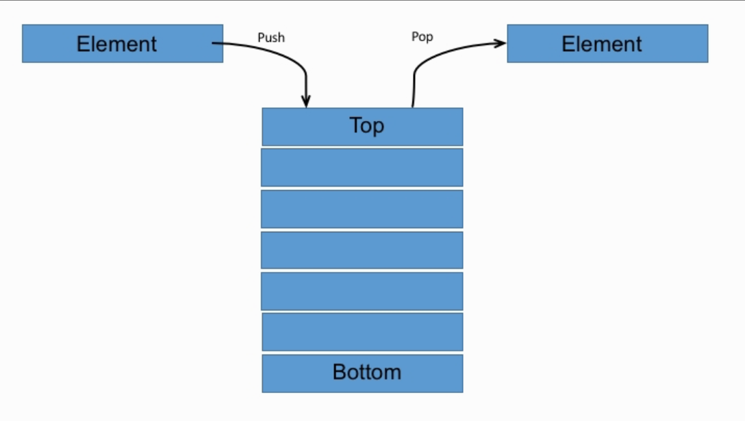
Stack
The stack is a linear data structure that is used to store the collection of objects.
It is based on Last-In-First-Out (LIFO).
Java collection framework provides many interfaces and classes to store the collection of objects.
One of them is the Stack class that provides different operations such as push, pop, search, etc.

Slide 8
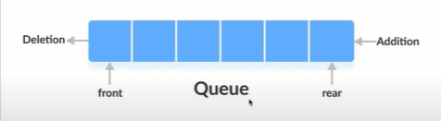
Queue Interface
Queue interface maintains the first-in-first-out order.
It can be defined as an ordered list that is used to hold the elements which are about to be processed.
Classes which implements the Queue interface
PriorityQueue
Deque
ArrayDeque

Slide 9
LinkedList
LinkedList implements the List/Queue interface
It can store the duplicate elements
The manipulation is fast because no shifting is required.

Slide 10
PriorityQueue
The PriorityQueue class implements the Queue interface.
It holds the elements or objects which are to be processed by their priorities.
PriorityQueue doesn't allow null values to be stored in the queue.
Array Deque
Deque interface extends the Queue interface.
In Deque, we can remove and add the elements from both the side.
Deque stands for a double-ended queue which enables us to perform the operations at both the ends.

Slide 11
Set Interface
It represents the unordered set of elements which doesn't allow us to store the duplicate items.
We can store at most one null value in Set.
Set is implemented by
HashSet
LinkedHashSet
TreeSet

Slide 12
HashSet
HashSet class implements Set Interface.
It represents the collection that uses a hash table for storage.
Hashing is used to store the elements in the HashSet.
It contains unique items

Slide 13
LinkedHashSet
Java LinkedHashSet class is a Hashtable and Linked list implementation of the Set interface.
It inherits the HashSet class and implements the Set interface.
It contains unique elements only like HashSet.
It provides all optional set operations and permits null elements.
It maintains insertion order.

Slide 14
TreeSet
Java TreeSet class implements the Set interface that uses a tree for storage.
Like HashSet, TreeSet also contains unique elements.
The access and retrieval time of TreeSet is quite fast.
The elements in TreeSet stored in ascending order.

Slide 15
Map Interface
A map contains values on the basis of key, i.e. key and value pair.
Each key and value pair is known as an entry.
A Map contains unique keys.
A Map is useful if you have to search, update or delete elements on the basis of a key.
Classes which implements the Map interface
HashMap
TreeMap

Slide 16
HashMap
Java HashMap class implements the Map interface which allows us to store key and value pair
It contains values based on the key.
It contains only unique keys.
It may have one null key and multiple null values.
It is non synchronized.
It maintains no order.

Slide 17
TreeMap
It provides an efficient means of storing key-value pairs in sorted order.
Java TreeMap maintains ascending order.
Java TreeMap contains only unique elements.
Java TreeMap cannot have a null key but can have multiple null values.

Slide 18
Comparable interface
Java Comparable interface is used to order the objects of the user-defined class.
This interface is found in java.lang package and contains only one method named compareTo(Object).
It provides a single sorting sequence only, i.e., you can sort the elements on the basis of single data member only.
CompareTo returns integer value
if s1 > s2, it returns positive number
if s1 < s2, it returns negative number
if s1 == s2, it returns 0

Slide 19
Comparator interface
It is used to order the objects of a user-defined class.
This interface is found in java.util package and contains 2 methods
compare(Object obj1,Object obj2)
equals(Object element).
It provides multiple sorting sequences, i.e., you can sort the elements on the basis of any data member, for example, rollno, name, age or anything else.

Slide 20
